Slide 1
Rest api
Noskheban

Slide 2
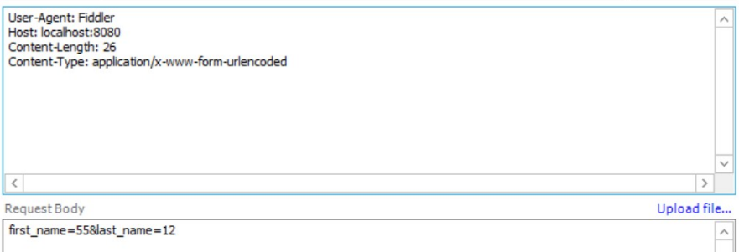
The format
Imagin we gonna post value ‘a’ for ‘A’ and value ‘b’ for ‘B’:
You should send something like this: A=a&B=b
Attention: they have no cotation and no space! (even if values are string)
Here is a sample in fiddler application:

Slide 3
login
It’s a post api for login and the address is: “/checkLogin”.
it will send “true” if informations exist or “false” otherwise.
These values are needed:
1.NC: it can be NationalCode or Username.
2.pass: the password.

Slide 4
register
It’s a post api for register a new user and the address is: “/register”.
it will send “false” if the user already exist (repetitive username or NC)
Or send datas in Json format otherwise.
These values are needed:
1.user: the username.
2.pass: the password.
3.Fname: user first name.
4.Lname: user last name.
5.NC: user national code.

